Slide 1
Points for presentations!!

Slide 2

Artificial Intelligence & Decision Systems
13.03.2024

Slide 3

Agenda
Classification types
Evaluate algorithms
Classification algorithms

Slide 4


Estimating function $f(x_{i})$, predicts the value of the output variable ${y′}_{i}$ by taking the associated features $x_{i}$ as an input.
Classification
$${y′}_{i}=f(x_{i})$$
The prediction task is a classification when the target variable is discrete.
The prediction task is a regression when the target variable is continous.

Slide 5

Dependent and independent variables
Independent Variables: The variable that are not affected by the other variables are called independent variables – data.
Dependent Variables: The variables which depend on other variables or factors. We expect these variables to change when the independent variables, upon whom they depend, undergo a change –target,

Slide 6
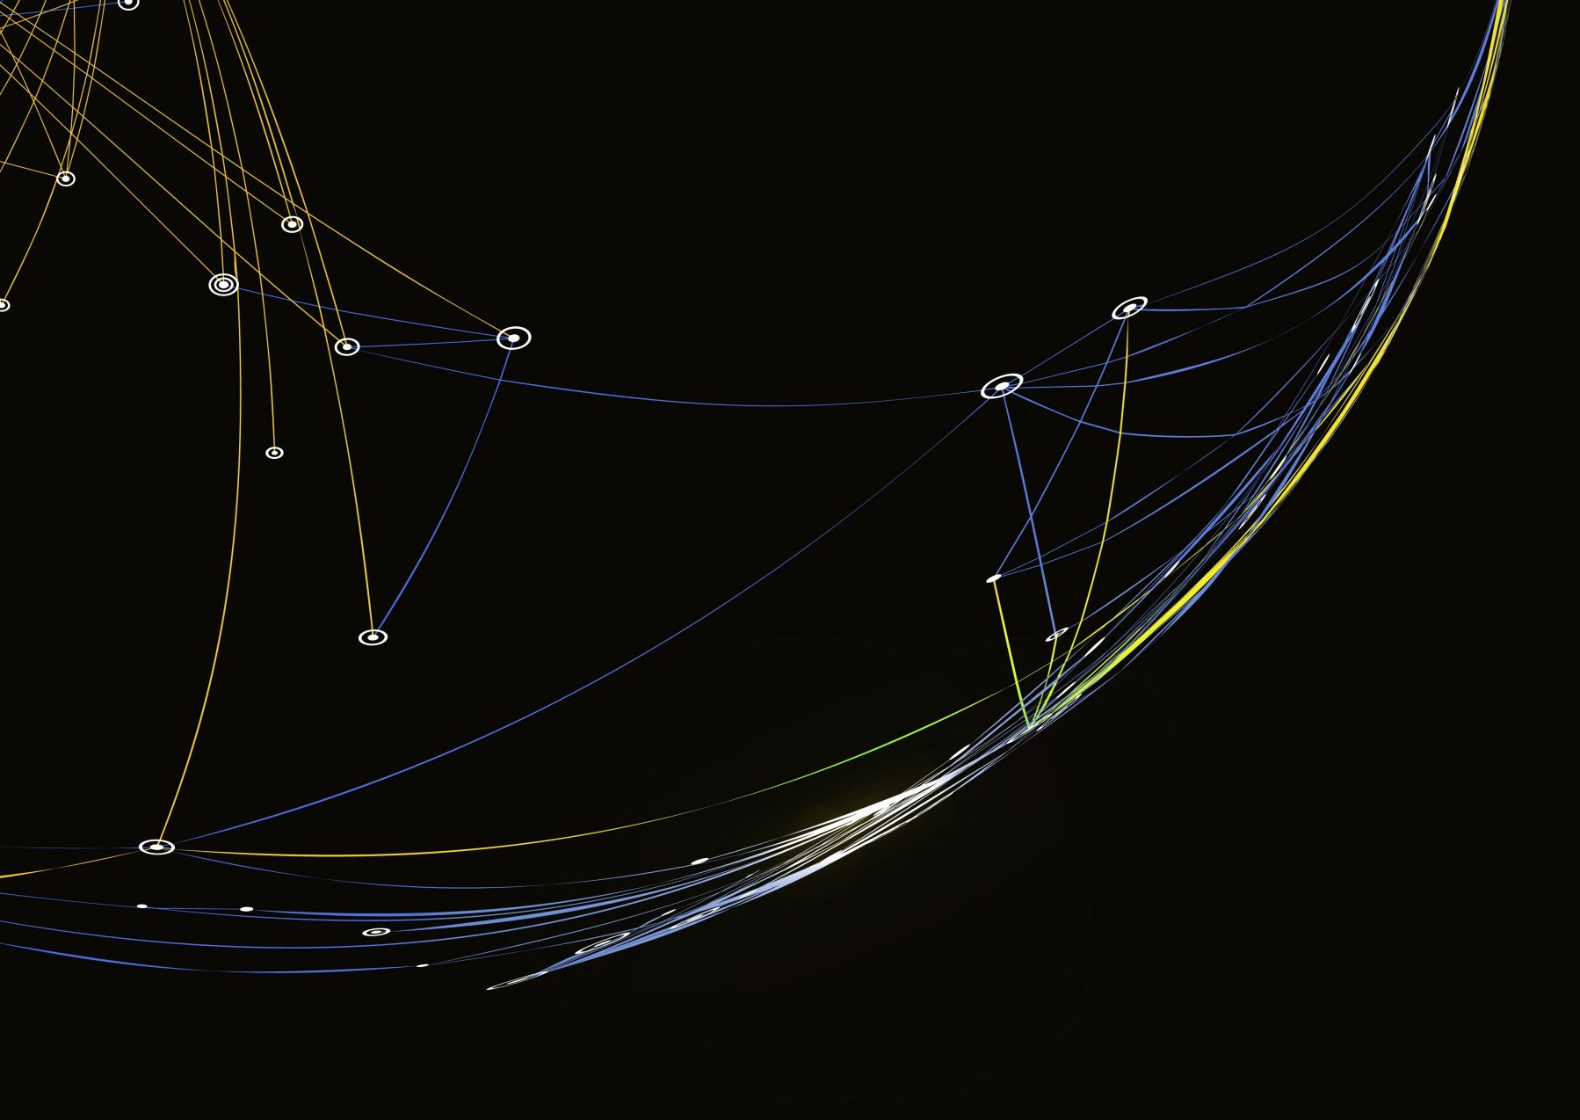
Types of classification
Binary Classification
Multi-Class Classification
Multi-Label Classification
Imbalanced Classification
One-Class Classification

Slide 7
Notebook s2

Slide 8

Binary Classification
Classifying the input data into two mutually exclusive categories;
The training data is labeled in a binary format;
0
Input
1

Slide 9
Multi-Class Classification
Has at least two mutually exclusive class labels
a
Input
b
c

Slide 10
Multi-Label Classification
Predict 0 or more classes for each input variable;
Input variable can have more than one label;
a
Input
b
c

Slide 11
Imbalanced Classification
The number of examples is unevenly distributed in each class
Solutions:
Gather more data
Sampling
SMOTE
Changing class weights
Class distribution chart

Slide 12
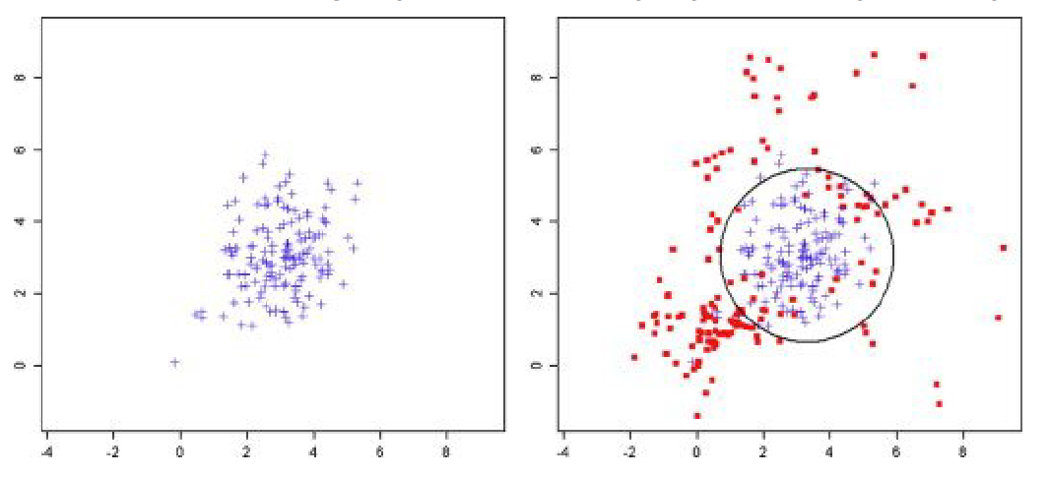
One-Class Classification
Identify objects of a specific class amongst all objects
Training set contains only the objects of that class
Used for detectiong anomaly or outliers

Slide 13
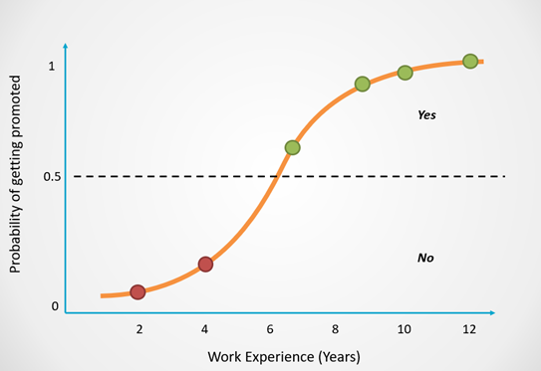
Decision Boundary
A set of hyper-planes, that separates the data points into specific classes, where the algorithm switches from one class to another.
p>=0.5, class=A
p<=0.5, class=B

Slide 14
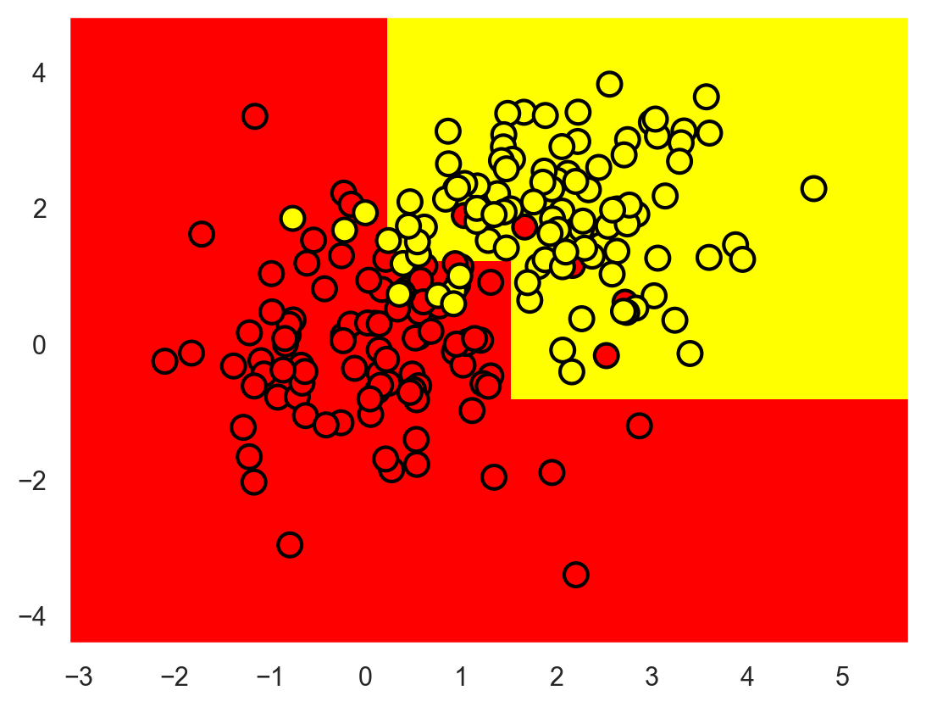
Types of decision boundaries
Linear
Non-linear
With hard margin
With soft margin

Slide 15
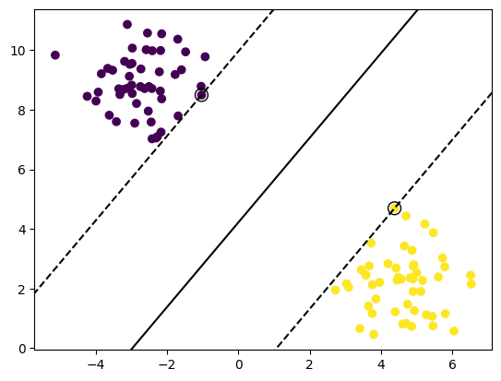
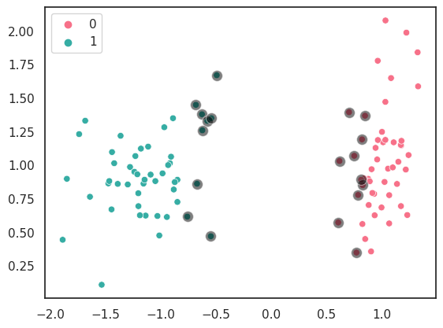
Hard and soft margin

Slide 16
Notebook s2_2

Slide 17

Learning process
Function iterates over the training data and updates the model parameters to minimize the loss function and errors.
Loss function - the difference between a model’s predictions and the actual target value in the dataset
Binary cross-entropy/ logistic loss
Categorical cross-entropy
Hinge loss
Squared hinge loss

Slide 18

Model evaluation
 | Predicted Positive | Predicted Negative
Actual Positive | True Positive | False Negative
Actual Negative | False Positive | True Negative
Type II Error
Type I Error
Accuracy = $\frac{TP+TN}{TP+FP+TN+FN}$
Error rate = $\frac{FP+FN}{TP+FP+TN+FN}$
Precision = $\frac{TP}{TP+FP}$
Recall/Sensitivity = $\frac{TP}{TP+FN}$
Specificity = $\frac{TN}{TN+FP}$
F1 score = $2∗\frac{Precision∗Recall}{Precision+Recall}$

Slide 19
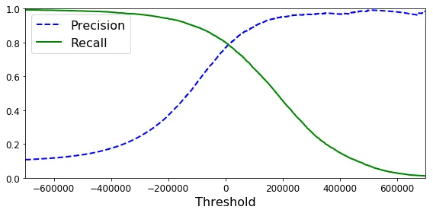
Precission-Recall Tradeoff

Slide 20
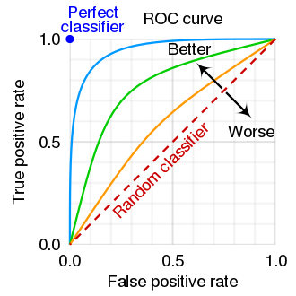

AUC-ROC
True positive rate = sensitivity
False positive rate = $\frac{FP}{FP+TN}$

Slide 21
Notebook s2_3

Slide 22

Underfitting and overfitting
High bias
High variance

Slide 23
Overfitting and underfitting
Overfitting
Underfitting
High accuracy for training set and low for testing set
Low accuracy for validation set
Solution:
Reduce complexity
Reguralization
Less training
More data
Low accuracy for training set and low for testing set
Low accuracy for validation set
Solution:
Increase complexity
More training
More data

Slide 24
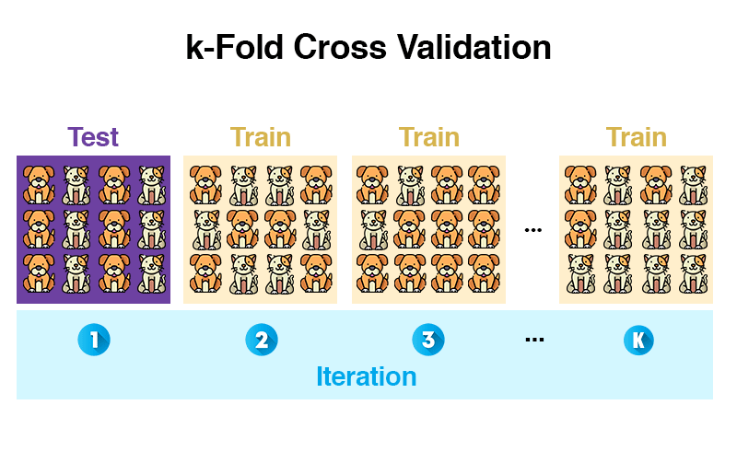
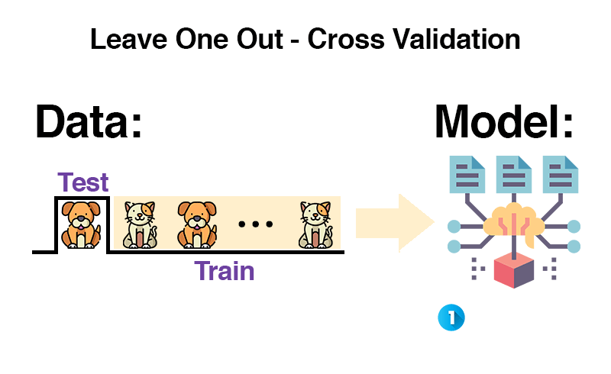
Train, test and validation
Train-test split:
Hold-out
Stratified
Cross-validation:
Leave-one-out
Leave-group-out (k-fold)
Stratified K-Fold

Slide 25
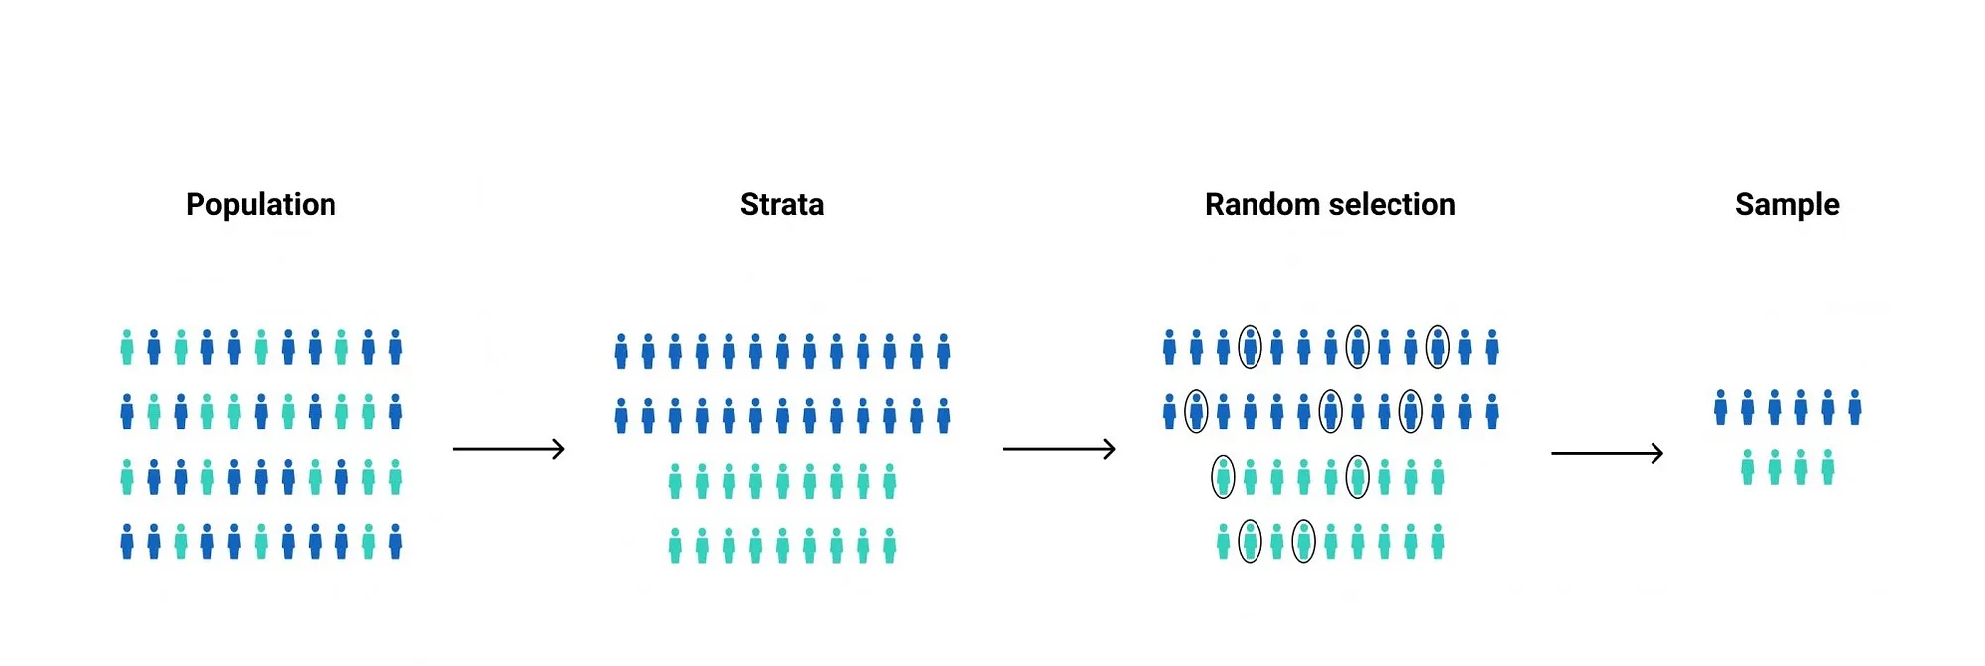
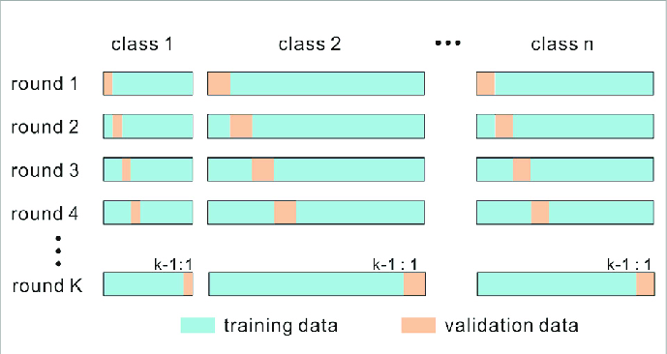
Stratified sampling

Slide 26
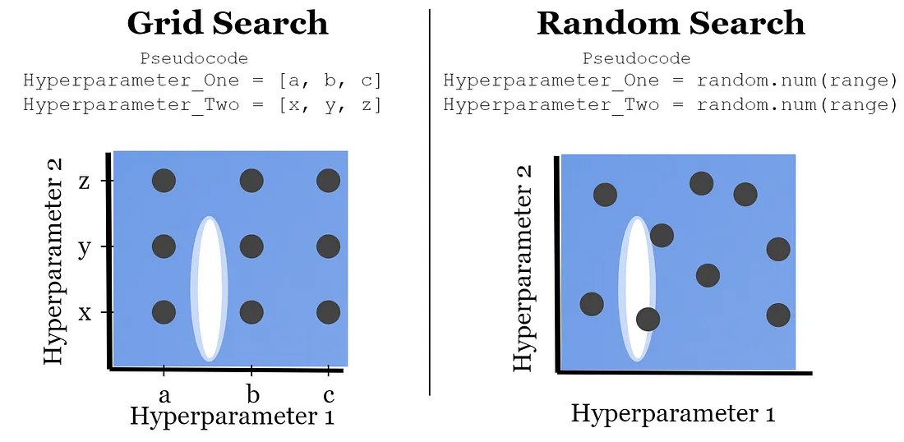
Optimalization

Slide 27
Questions?

Slide 28


